Slide 1
BCOG 100
The Evolution of Neurons
Lecture 1: Evolution and the Beginning of Life

Slide 2
Reading Check 4-1
Password: neuron
Question: Neurons are described as creating “electrochemical” communication. What does that mean?

Slide 3
From Evolution to Neurons
Today’s Outline
Why biology in cognitive science?
Evolution by natural selection
Origins of life & early “intelligence”
Notes:
Today we’re starting a new arc in the course: building up the human brain from an evolutionary perspective.
Until now we’ve been asking big philosophical and methodological questions — what counts as knowledge, what logic is, how science works. Now we’re going to pivot into biology.
Why? Because brains are biological organs, and cognition is built on biology.
To understand how the human mind works, we need to know where brains came from and why they’re designed the way they are.
So in today’s lecture, we’ll start with the very basics: how evolution by natural selection works, how life began, and how even simple cells had surprisingly intelligent behaviors.
We’ll then talk about a major dilemma that all life on Earth faced, and how the evolution of the neuron was a solution that some organisms took to solve this problem.
This will set the stage for neurons, and later for brains and cognition.”

Slide 4
From Evolution to Neurons
Why Biology Matters for Cognitive Science
Brains are biological organs
Evolution shaped cognition by shaping the brain
Constraints, tradeoffs, and possibilities
Simple life and evolution itself can be thought of as a kind of intelligent, information, processing, and algorithm
Over the next 8 weeks we’ll go from:
Molecules → Cells → Neurons
Circuits
Brains
Higher Cognitive Abilities like Symbolic Reasoning, Language and Social Cognition.
This mirrors both evolution and our course.
Notes:
Why are we pausing on biology in a cognitive science course?
Because cognition isn’t abstract — it runs on brains, and brains are biological organs.
Evolution shaped how brains work: what they can do really well, where they have limitations, and why they look the way they do.
Just like an engineer can’t build a plane out of anything but the materials available, evolution couldn’t build minds out of anything except cells, neurons, and proteins.
By understanding the biological constraints and tradeoffs evolution imposed, we get insight into why human cognition has certain features:
why we can reason in some ways but not others,
why memory is organized the way it is,
and why perception works the way it does.
In other words, biology doesn’t just tell us how brains work — it also tells us why they work the way they do.

Slide 5
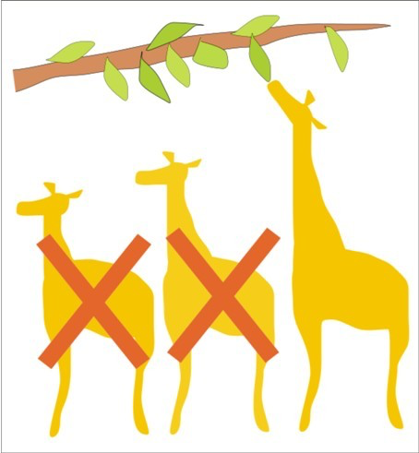
Evolution by Natural Selection
Natural Selection as an Algorithm
Variation: individuals in a population vary in their traits; they have different genotypes (sets of genes) leading to different phenotypes (differences in physical bodies and behaviors).
Inheritance: those traits are passed on to offspring
Selection: traits that help organisms survive and reproduce are “selected”; they become more common over generations. Sometimes also called “differential survival and reproduction”.
Notes:
To understand how neurons — and eventually brains — evolved, we first need to remind ourselves how evolution by natural selection works.
For evolution by natural selection to work, there are three key ingredients:
Variation: individuals in a population vary in their traits; they have different genotypes (sets of genes) leading to different phenotypes (differences in physical bodies and behaviors).
Inheritance: those traits are passed on to offspring
Selection: traits that help organisms survive and reproduce are “selected”; they become more common over generations. Sometimes also called “differential survival and reproduction”.
That’s it. With these three ingredients, natural selection produces complexity and adaptation.
And note that this isn’t just to say that variation, inheritance, and selection are sufficient for natural selection to occur.
Natural selection will necessarily occur when all there of these properties are present.
Understanding the process of natural selection and its implications can help us better understand a lot about living things— including, eventually, the complexity of neurons, brains, and intelligence.

Slide 6
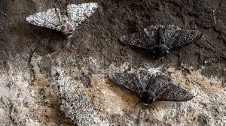
Evolution by Natural Selection
Example
Peppered moths (light vs. dark)
Industrial Revolution → pollution darkened trees
Selection favored darker moths
Notes:
Let’s look at a classic case that shows natural selection at work: the peppered moths in England.
Originally, most moths were light-colored, which camouflaged them against the lichen-covered trees., which were very light in color.
But during the Industrial Revolution, soot darkened the trees.
Suddenly, the light moths were more visible to predators, while darker moths were better camouflaged.
As a result, the dark moths had higher survival and reproduction.
Over time, the population shifted, and darker moths became much more common.
This is natural selection in action: variation in coloration, inheritance of those traits, and selection based on environmental pressures.
We’ll use this same logic to understand how neurons — and eventually brains — were selected for in certain environments.

Slide 7
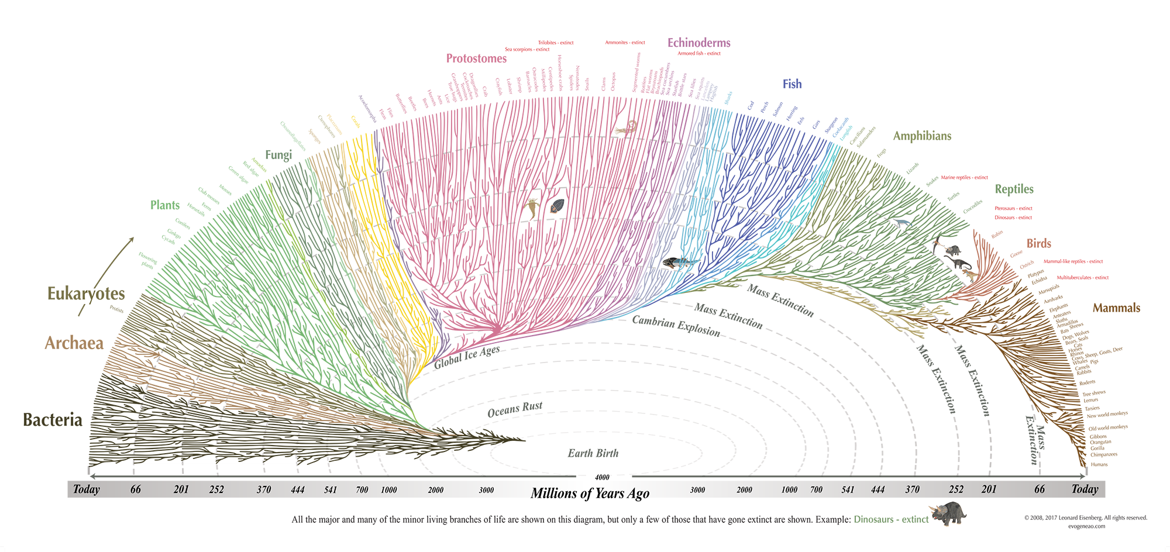
Evolution by Natural Selection
Evolution ≠ Progress
Not “progress” or a ladder
Evolution = adaptation to environment
Traits can be gained or lost, depending on whether those traits benefit survival or reproduction in the current environment.
Notes:
Before we move on, It’s important to clear up a common misconception.
Evolution is not a march of progress toward some goal, like humans at the top of a ladder.
Instead, evolution is about adaptation to local environments.
What works in one context may not in another. Traits can be gained, but they can also be lost if they’re no longer useful.
Think about cave fish that lost their eyes.
Or parasites that lost digestive systems because they live entirely inside hosts.
These changes weren’t ‘backward’—they were adaptive for those environments.
This is crucial for our purposes: neurons and brains didn’t evolve because evolution was trying to ‘make intelligence.’
They evolved because, in certain ecological situations, they helped organisms survive and reproduce.
Intelligence isn’t inherently a “good” thing by evolutionary standards. It might be adaptive in certain situations, and maladaptive in others.
By the way, from an evolutionary perspective, intelligence isn’t even all that common.
What we call ‘intelligent’ organisms are vastly outnumbered by bacteria, fungi, and other so-called ‘simple’ life forms.
From nature’s point of view, being intelligent is the exception, not the rule.

Slide 8
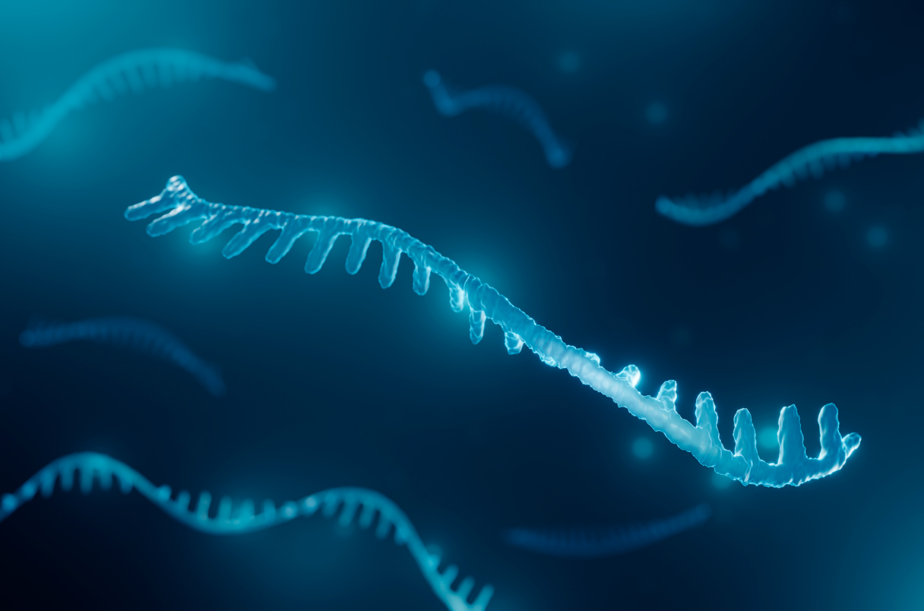
The Evolution of the First Cells
Early Earth, Abiogenesis, & RNA World Hypothesis
~4 billion years ago: early Earth
random chemistry resulted in short RNA chains
Some RNA happened to be ribozymes (catalysts)
Rare ribozymes helped copying → replication
Copying was imperfect → variation
Some variants were better at surviving or copying themselves → selection
Variation + inheritance + selection = evolution begins
Notes:
On the early Earth about 4 billion years ago, random chemistry produced short chains of RNA.
Most of these just broke down, but a few folded into useful shapes.
Useful because they could catalyze chemical reactions.
These special RNAs are called ribozymes.
Every once in a while, a ribozyme helped an RNA chain get copied.
It wasn’t direct, efficient self-copying the way modern DNA replication works.
But even an indirect, clumsy process was a game-changer.
Because copying was imperfect, mistakes crept in — new variants appeared.
Some were better at surviving or making more copies, and those variants spread.
At this point, all three ingredients for natural selection were in place: variation, inheritance, and differential survival. In other words, evolution had begun — not yet with cells or organisms, but with relatively simple molecules.

Slide 9
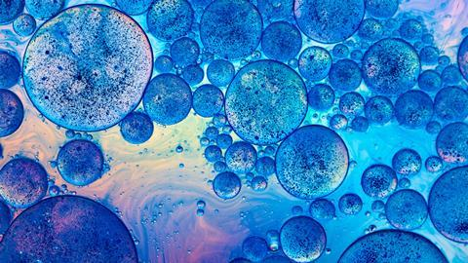
The Evolution of the First Cells
Early Adaptations
Lipids resulting in membranes (protect & contain RNA)
Ribozymes develop into ribosomes (protein factories)
Proteins can enrich complexity: catalysts, energy metabolizers, motors, sensors
DNA = stable blueprint
Notes:
Once evolution was underway, certain innovations dramatically increased the complexity of these proto-cells.
Lipids: Fatty molecules naturally form bubbles in water. If RNA systems got trapped inside, they gained protection.
Over time, RNAs and proteins that could help maintain or produce membranes were favored. This was the beginning of true cell membranes.
Ribozymes → Ribosomes: Some RNAs catalyzed reactions that joined amino acids into short chains — the first proteins.
Proteins were more versatile than RNA enzymes, so any system that produced them had an edge.
Eventually, ribozymes and proteins co-evolved into ribosomes — dedicated machines for protein production.
Proteins: These short chains could act as catalysts, energy metabolizers, sensors, or motors — dramatically expanding what early life could do.
DNA: Finally, DNA entered the scene as a more stable storage molecule than RNA.
RNA and proteins did the work, while DNA became the long-term blueprint.
By the time these pieces came together, life looked much more like what we’d recognize as a modern cell:
a membrane, a genome, protein factories, and a metabolism powered by ATP.

Slide 10
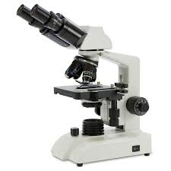
The Evolution of the First Cells
How do we know this?
chemistry shows it’s possible,
biology shows traces of an RNA world still remain,
geology sets the timeline,
and comparative genomics shows what early cells must have had.
Notes:
1. Chemistry experiments
Classic Miller–Urey experiment (1950s) showed that with simple gases, sparks, and heat, you can get amino acids and nucleotides.
Modern versions with clays, minerals, and hydrothermal vent conditions show that short RNA and peptide chains can form spontaneously.
2. Ribozymes in modern biology
In labs, scientists have evolved RNAs that can catalyze their own partial copying.
In living cells, ribozymes still exist: the catalytic core of the ribosome is RNA, not protein. That’s a fossil of the RNA world.
3. Comparative biology (LUCA reconstruction)
By comparing genes across bacteria, archaea, and eukaryotes, scientists can infer what the last universal common ancestor (LUCA) had (DNA, ribosomes, ATP use, membranes).
Anything shared across all life today probably existed in LUCA.
4. Geological evidence
Ancient rocks (~3.5–3.8 billion years old) contain chemical signatures consistent with early life: carbon isotope ratios, stromatolite fossils.
These set a minimum date for when life had to exist.
5. Computer models & lab evolution
Researchers simulate networks of replicators and show how self-replication, variation, and selection naturally emerge.
In labs, RNA molecules have been artificially evolved to improve replication — demonstrating plausibility.

Slide 11
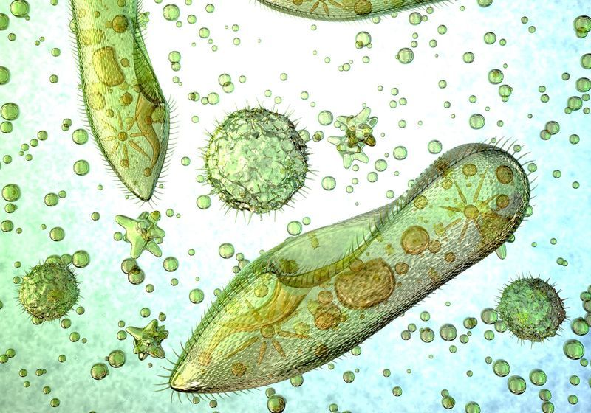
The Evolution of the First Cells
Early Intelligence in Single-Celled Life
Single cells with proteins for:
Movement (propellers, motors)
Sensing (light, temperature, chemicals)
This resulted in behavior:
Move toward food
Avoid danger
Cells with adaptive behaviors had a better chance of survival and reproduction, and so came to outnumber those that did not.
Notes:
Even before neurons existed, life was already showing what we could call primitive intelligence.
Single-celled organisms like bacteria evolved proteins that acted like little machines.
Some proteins formed motors and propellers that let them swim through liquid.
Others acted as receptors, changing shape when they detected things in the environment, like light, heat, or chemicals.
This allowed bacteria to do more than just sit there.
They could actively navigate:
Swim toward food sources that supported replication.
Swim away from harmful chemicals, extreme heat, or anything that damaged their DNA.
This behavior is called chemotaxis — literally ‘movement in response to chemicals.’
It’s not neurons, but it’s the same basic idea: detecting the world and acting in ways that increase survival.

Slide 12
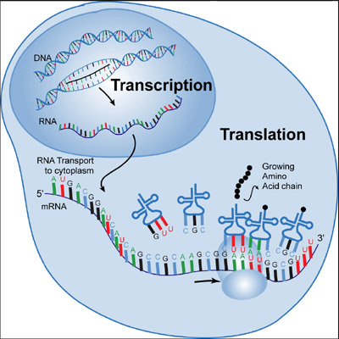
The Evolution of the First Cells
DNA as Information Storage
DNA = stable blueprint
RNA = messenger, helper
Proteins = machines
Central Dogma: DNA → RNA → Protein
Notes:
We often think about and talk about the brain as an information processing system. And it is.
But we shouldn’t miss that even the very basics of life are also another type of information processing system.
Once DNA took over, life had a system for storing and using information.
DNA is the storage medium, a long-term archive.
RNA is the messenger, transmitting information from storage to action.
Proteins carry out the actions — building, moving, sensing.
This is called the central dogma of molecular biology: DNA makes RNA, RNA makes proteins.
DNA itself doesn’t directly “do” the information processing. But it creates a set of systems that do.
Compare that to brains. Neurons store and transmit information in networks.
Just like DNA doesn’t ‘do’ anything on its own but encodes instructions, many mental representations are only useful because they can be transformed and acted on.
In both biology and cognition, understanding information flow is key: how it’s stored, transmitted, and transformed is what makes complex systems possible.

Slide 13
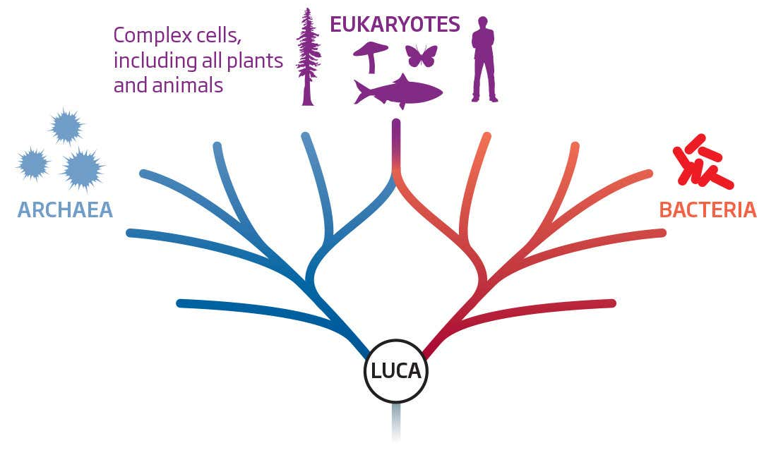
The Evolution of the First Cells
LUCA: Last Universal Common Ancestor
~3.5 billion years ago
Shared by all life today
Features:
DNA, RNA, proteins
Lipid membranes
ATP metabolism
Notes:
All living things — fungi, plants, bacteria, animals, us — share a common ancestor known as LUCA:
the Last Universal Common Ancestor, about 3.5 billion years ago.
LUCA already had DNA, RNA, proteins, lipid membranes, and used ATP for energy.
That means those features are not late inventions — they’re fundamental, shared by all life on Earth.
LUCA wasn’t the first living thing, but it’s the ancestor of everything alive today.

Slide 14
The Energy Challenge in Early Life
The Energy Challenge
ATP: adenosine triphosphate, a cell’s energy currency
Early life: hydrogen fuel → ATP (inefficient)
Photosynthesis: sunlight + CO₂ → sugar → ATP (efficient, renewable)
Notes:
All living cells run on the same battery molecule: ATP — adenosine triphosphate.
Cells make ATP and then spend it to power everything: repairing DNA, building proteins, moving, dividing.
How did the first cells make ATP? Early life used hydrogen gas (H₂) as a fuel.
Here’s how that worked:
Hydrogen (H2) electrons don’t bind very tightly.
When those electrons were transferred to other molecules that held them more tightly, the ‘fall’ releases energy.
Cells captured that energy by pumping protons (H⁺) across their membranes — like storing water behind a dam.
As protons flowed back in, a protein machine called ATP synthase spun like a turbine, using that flow to make ATP.
It worked, but it wasn’t very efficient. Cells were always starved for energy.
Then came photosynthesis.
Some microbes figured out how to capture sunlight directly, use it to split water, and build sugars from carbon dioxide.
Those sugars could then be broken down to make much more ATP.
This was revolutionary: suddenly life had a powerful and renewable energy source.
Cells could produce ATP far more efficiently, which opened the door to greater complexity.

Slide 15
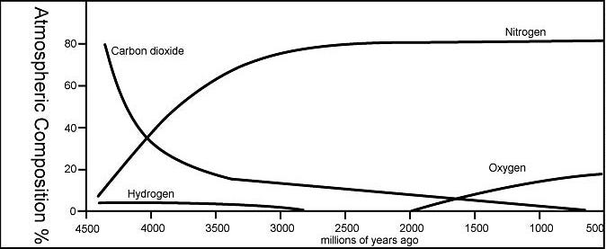
The Energy Challenge in Early Life
Great Oxygenation Event
Photosynthesis released oxygen (O₂)
Oxygen = toxic & reactive → mass extinction
Oxygen = powerful electron acceptor
Respiration with O₂ → ~15× more ATP
Notes:
Photosynthesis didn’t just create sugars — it also produced oxygen gas (O₂) as waste.
At first, this was catastrophic.
Oxygen is extremely reactive, so it damaged DNA and proteins.
Many microbes couldn’t survive it. This led to one of Earth’s first mass extinctions, sometimes called the ‘Oxygen Holocaust.’
But oxygen also created an enormous opportunity. Why? Because oxygen is a very strong electron acceptor.
Remember: early cells made ATP by transferring electrons from fuels like hydrogen to other molecules that grabbed them more tightly.
Oxygen grabs electrons more strongly than almost anything else.
That means electrons ‘fall’ further, releasing much more energy.
Cells that figured out how to use oxygen could suddenly make about 15 times more ATP from the same amount of fuel.
That huge energy boost gave them the capacity for bigger, more active, and more complex forms of life.
So oxygen was both poison and opportunity: it killed many lineages, but it powered the rise of life forms that would eventually lead to neurons and brains.

Slide 16
Summarizing Evolution of Life Before Neurons
Today we saw:
Evolution by natural selection = variation + inheritance + selection
Life from non-life: the RNA world → DNA, proteins, membranes
Early “intelligence” in single cells (chemotaxis)
Energy revolution: photosynthesis & oxygen
Next time…
Oxygen killed many forms of life…
…but also powered new complexity
With this energy, life could afford bigger bodies, new strategies, and the first neurons
Notes:
Photosynthesis didn’t just create sugars — it also produced oxygen gas (O₂) as waste.
At first, this was catastrophic.
Oxygen is extremely reactive, so it damaged DNA and proteins.
Many microbes couldn’t survive it. This led to one of Earth’s first mass extinctions, sometimes called the ‘Oxygen Holocaust.’
But oxygen also created an enormous opportunity. Why? Because oxygen is a very strong electron acceptor.
Remember: early cells made ATP by transferring electrons from fuels like hydrogen to other molecules that grabbed them more tightly.
Oxygen grabs electrons more strongly than almost anything else.
That means electrons ‘fall’ further, releasing much more energy.
Cells that figured out how to use oxygen could suddenly make about 15 times more ATP from the same amount of fuel.
That huge energy boost gave them the capacity for bigger, more active, and more complex forms of life.
So oxygen was both poison and opportunity: it killed many lineages, but it powered the rise of life forms that would eventually lead to neurons and brains.

